Slide 1
vintage game design
day 1

Slide 2
right place?

Slide 3
the deal

Slide 4


Slide 5
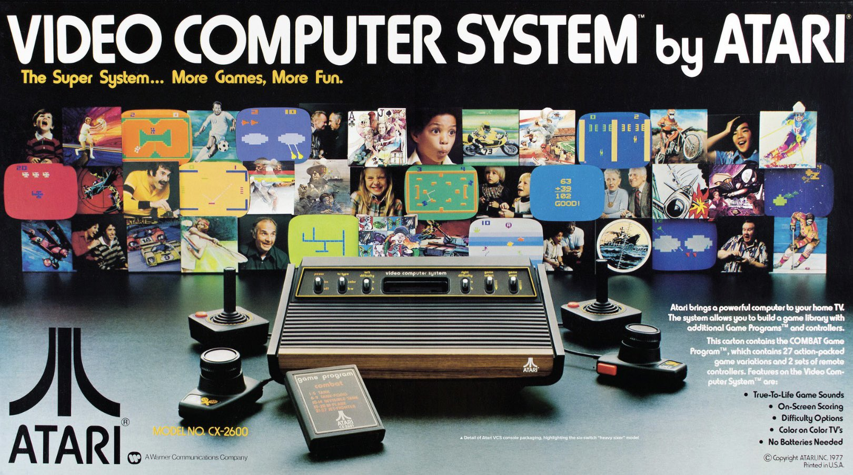
Notes:
So, Atari was not the first game company. Hell, it wasn’t even the first generation of console. It didn’t create video games, we can say those began even as far back as the 1800s with the mechanical turk.
But, this is where we can say video games established a few things.

Slide 6
not the origin but where it started
Notes:
So, Atari was not the first game company. Hell, it wasn’t even the first generation of console. It didn’t create video games, we can say those began even as far back as the 1800s with the mechanical turk.
But, this is where we can say video games established a few things.

Slide 7
what matters?
Notes:
So, Atari was not the first game company. Hell, it wasn’t even the first generation of console. It didn’t create video games, we can say those began even as far back as the 1800s with the mechanical turk.
But, this is where we can say video games established a few things.

Slide 8
credits for designers
Notes:
So, Atari was not the first game company. Hell, it wasn’t even the first generation of console. It didn’t create video games, we can say those began even as far back as the 1800s with the mechanical turk.
But, this is where we can say video games established a few things.

Slide 9
3rd party games
Notes:
So, Atari was not the first game company. Hell, it wasn’t even the first generation of console. It didn’t create video games, we can say those began even as far back as the 1800s with the mechanical turk.
But, this is where we can say video games established a few things.

Slide 10
pipelines
Notes:
So, Atari was not the first game company. Hell, it wasn’t even the first generation of console. It didn’t create video games, we can say those began even as far back as the 1800s with the mechanical turk.
But, this is where we can say video games established a few things.

Slide 11
what a video game is
Notes:
So, Atari was not the first game company. Hell, it wasn’t even the first generation of console. It didn’t create video games, we can say those began even as far back as the 1800s with the mechanical turk.
But, this is where we can say video games established a few things.

Slide 12
legendary games
Notes:
So, Atari was not the first game company. Hell, it wasn’t even the first generation of console. It didn’t create video games, we can say those began even as far back as the 1800s with the mechanical turk.
But, this is where we can say video games established a few things.

Slide 13
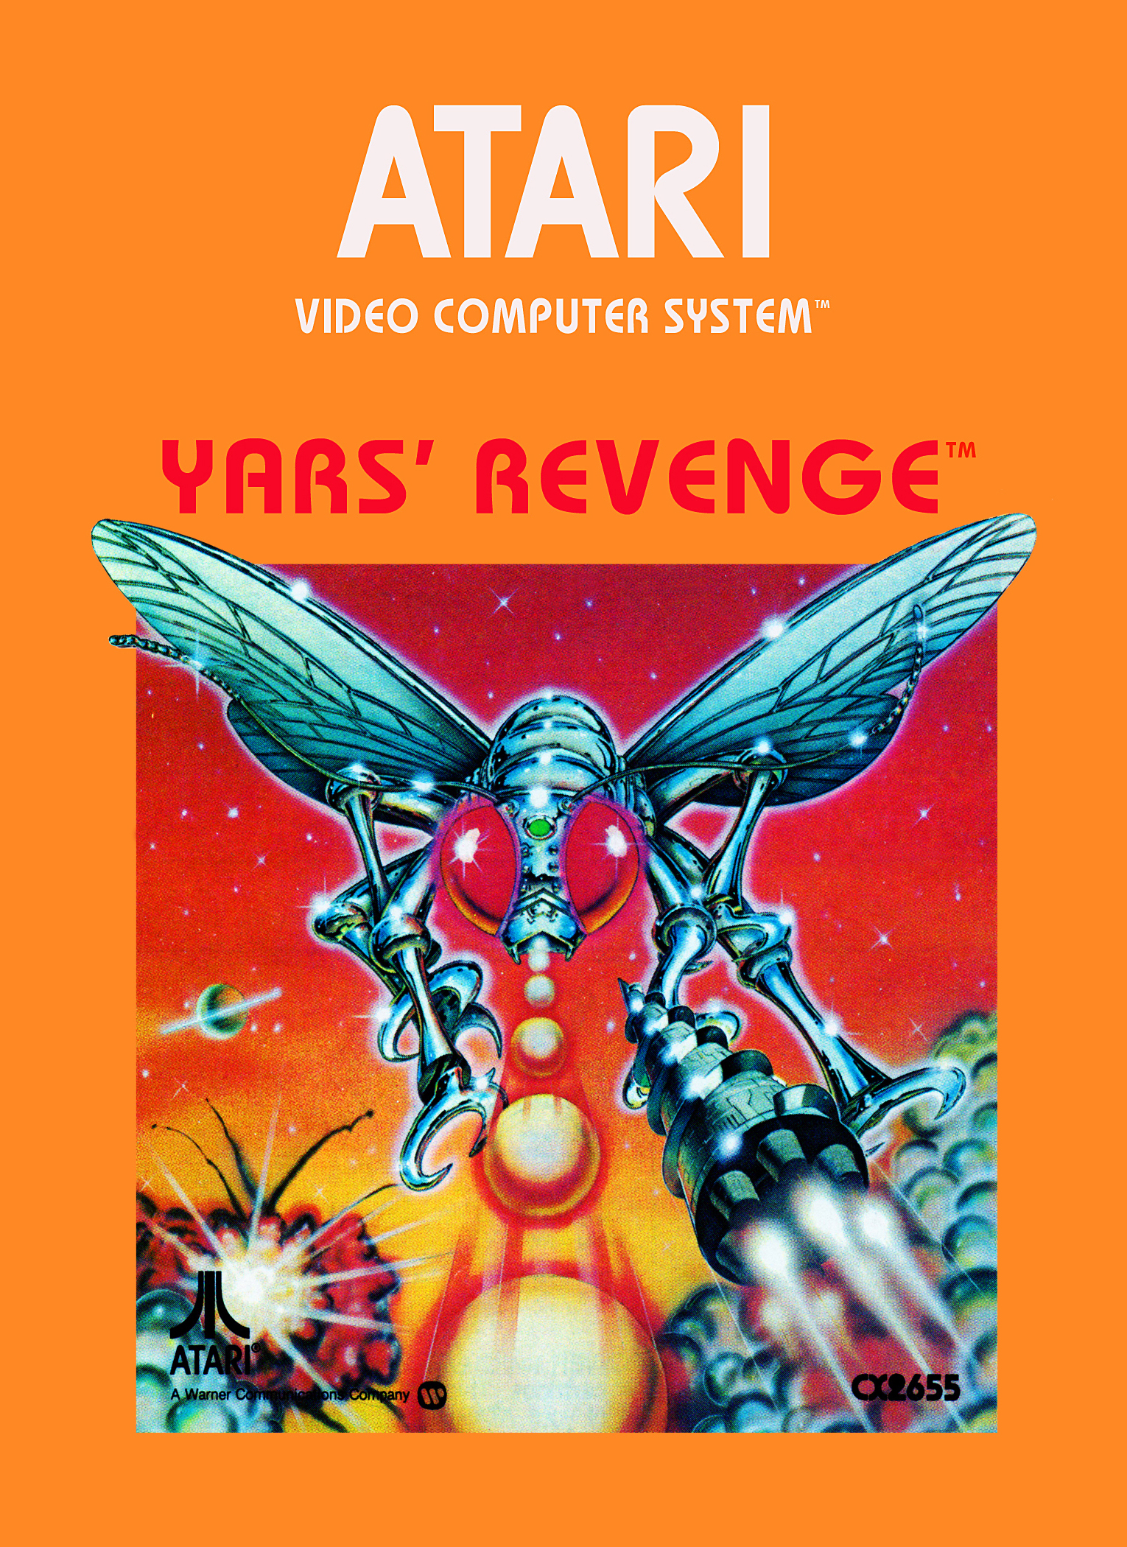
Howard Scott Warshaw still considered a top 100 game

Slide 14
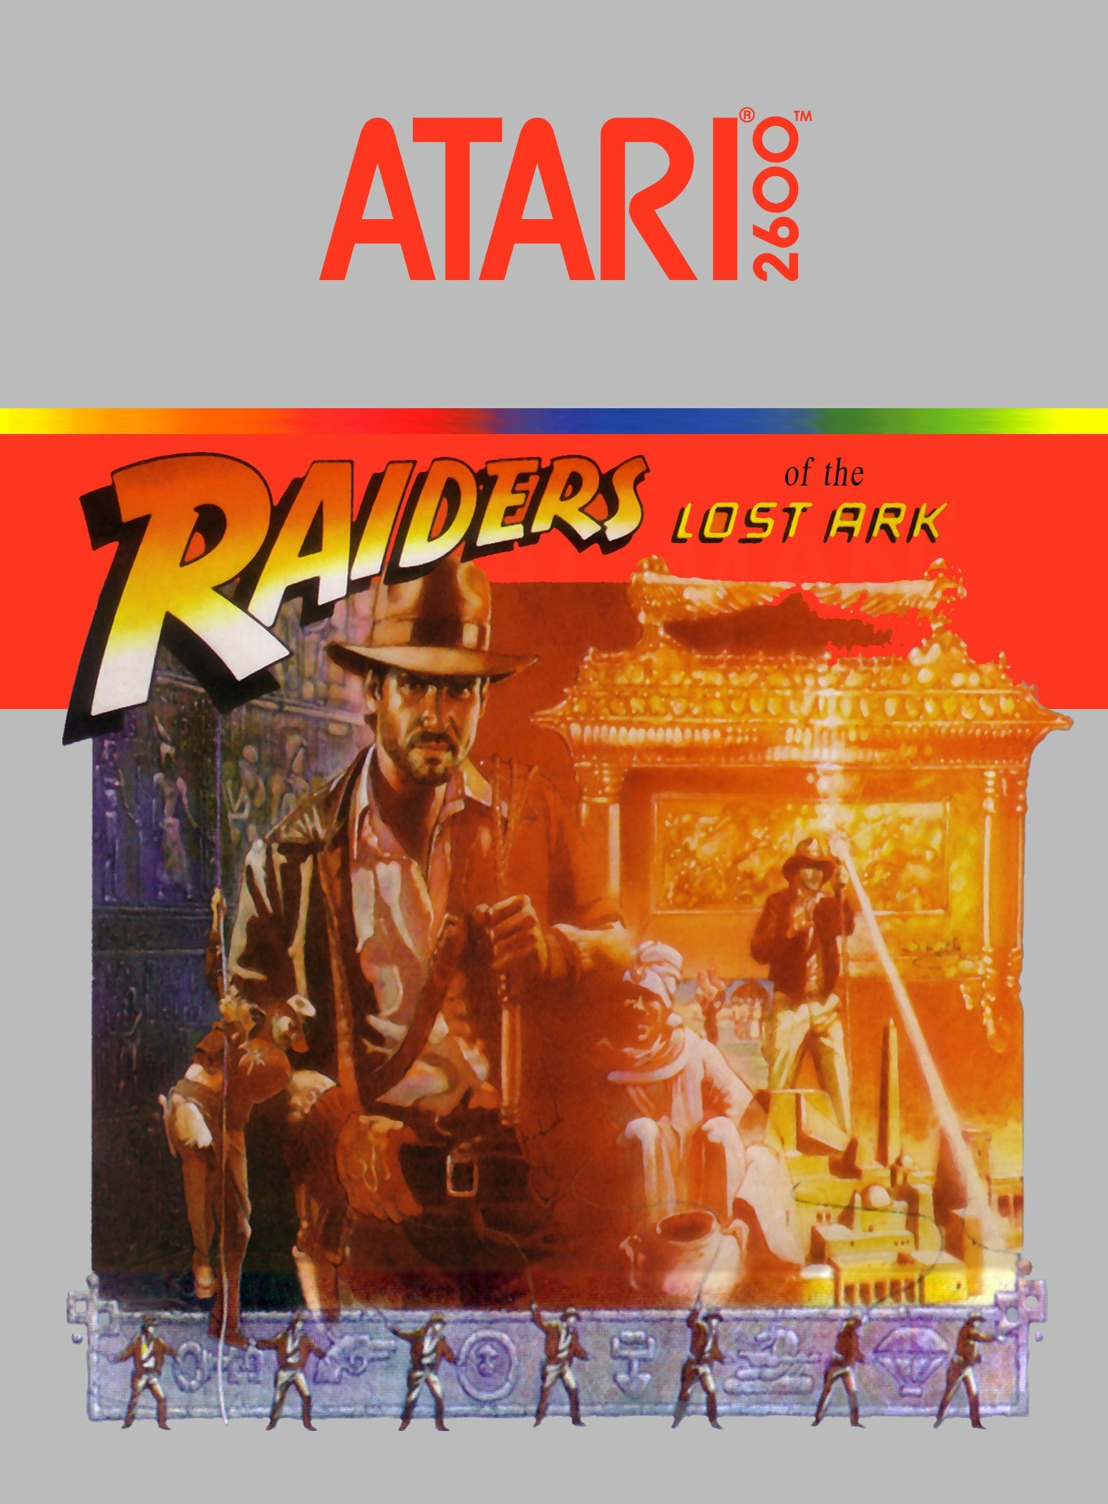
Howard Scott Warshaw surprisingly complex

Slide 15
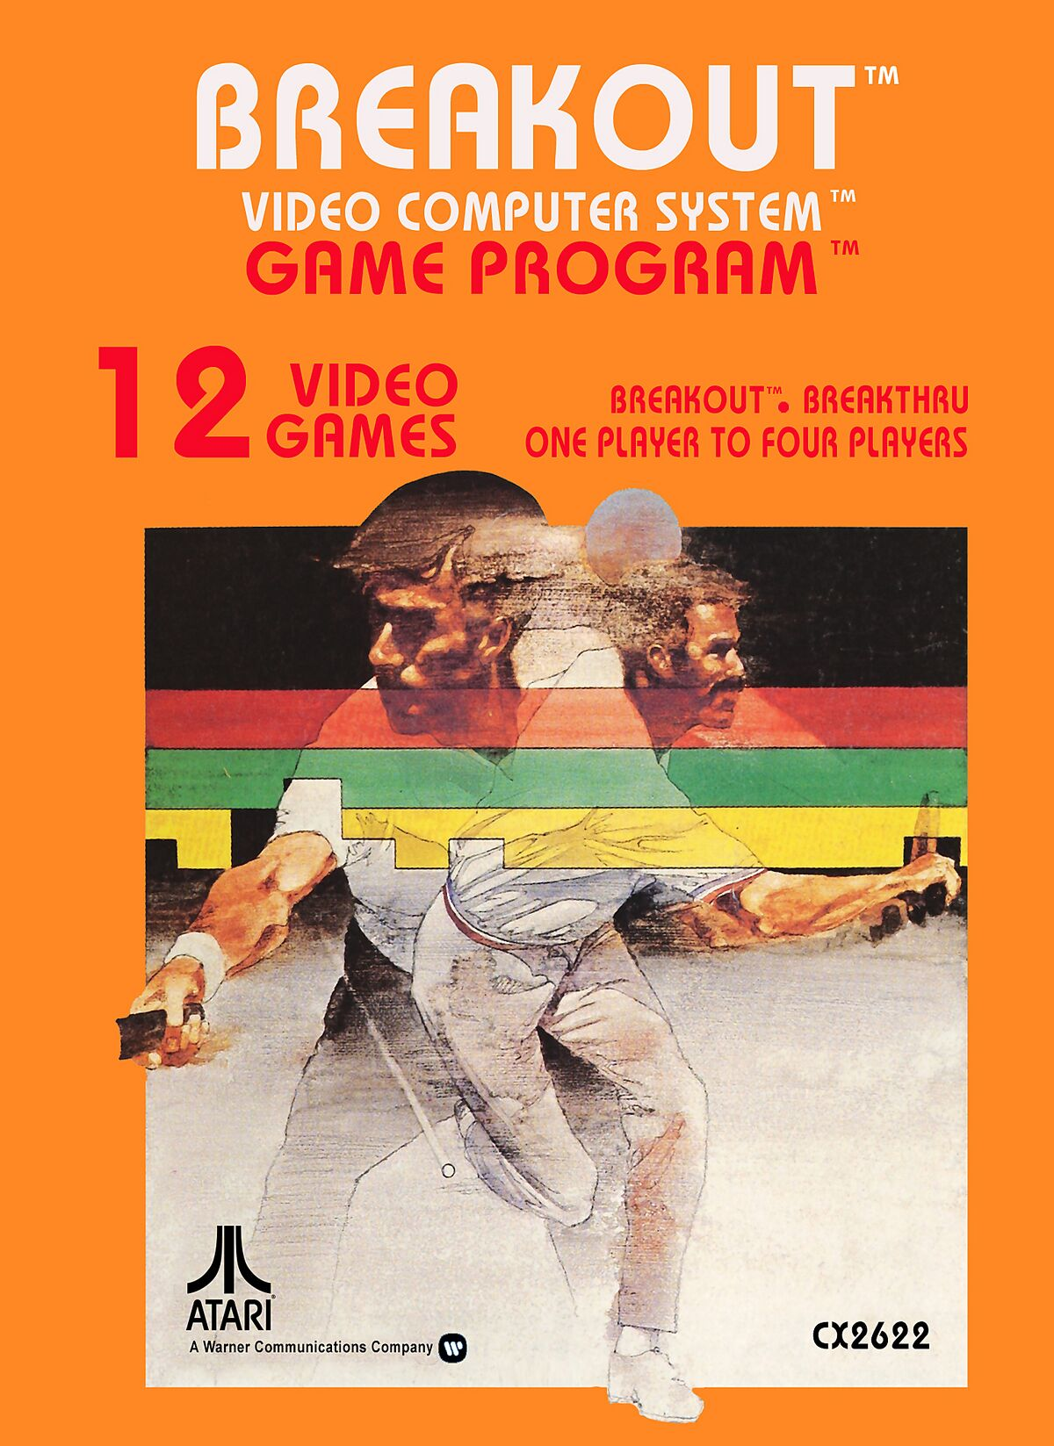
why is this here?

Slide 16
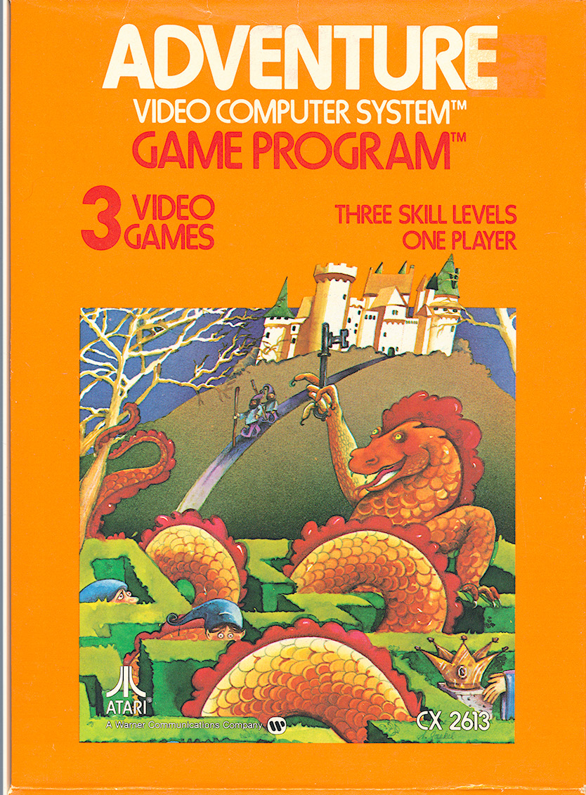
You guys are no more important to Atari than the guy on the assembly line who assembles the cartridges.

Slide 17
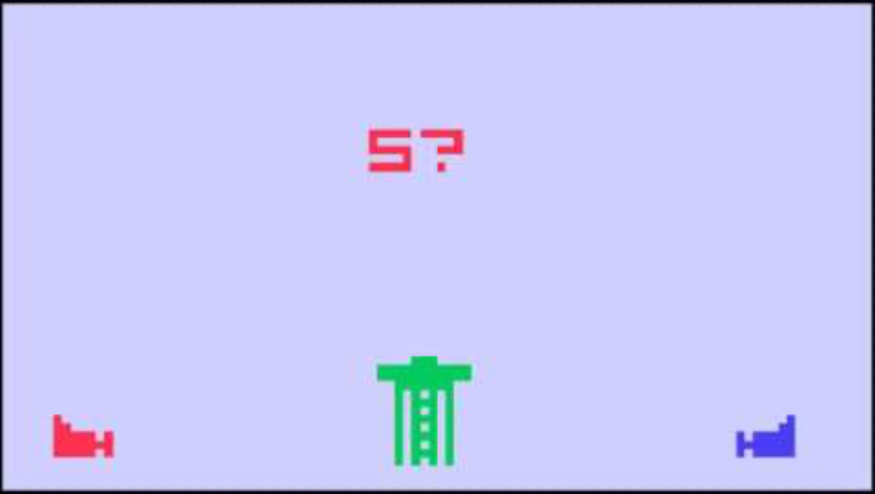

Slide 18

Carol Shaw Best Selling Scrolling Still important
Notes:
River Raid: https://www.inverse.com/gaming/river-raid-40th-anniversary-carol-shaw
One of the best selling games for the 2600, ported everywhere. One of the first games designed by a woman. The source code for this game is at the Strong. She hand wrote it.

Slide 19
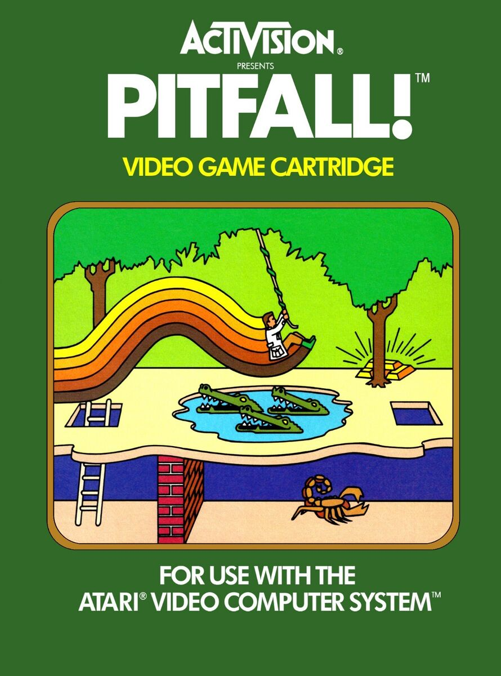
David Crane 255 Screens platformer procgen
Notes:
Crane commented that "The entire [game design] process took about 10 minutes. About 1000 hours of programming later the game was complete."^{[11]} Much of Crane's time was spent optimizing and compressing the code so that it would fit into a four-kilobyte ROM cartridge.^{[16]} Unlike Haunted House (1982) or Raiders of the Lost Ark (1982), where the environments were hard-coded into the game, Pitfall! was generated constantly by code.^{[13]} The game generates each screen based on a counter that could run either backwards or forwards depending which direction the player moved from screen to screen.^{[17]} The 8 bits in the counter were used to determine certain details such as the background, trees, ground and object patterns, allowing 255 screens to occupy fewer than 50 bytes of ROM.^{[18]} Activision had created design centers for their games, which were small, close-knit teams of four to five people.^{[19]} These teams encouraged peer reviews and shared prototypes of games. In Pitfall!, Crane's team changed the initial number of lives in the game from one to three during the final week of development.^{[20]} Crane said that "my buddies practically tied me to my chair until I put in extra lives and I'm glad they did".^{[20]}

Slide 20
how class work?

Slide 21
assembly 6502

Slide 22
3 tasks

Slide 23
read and write

Slide 24
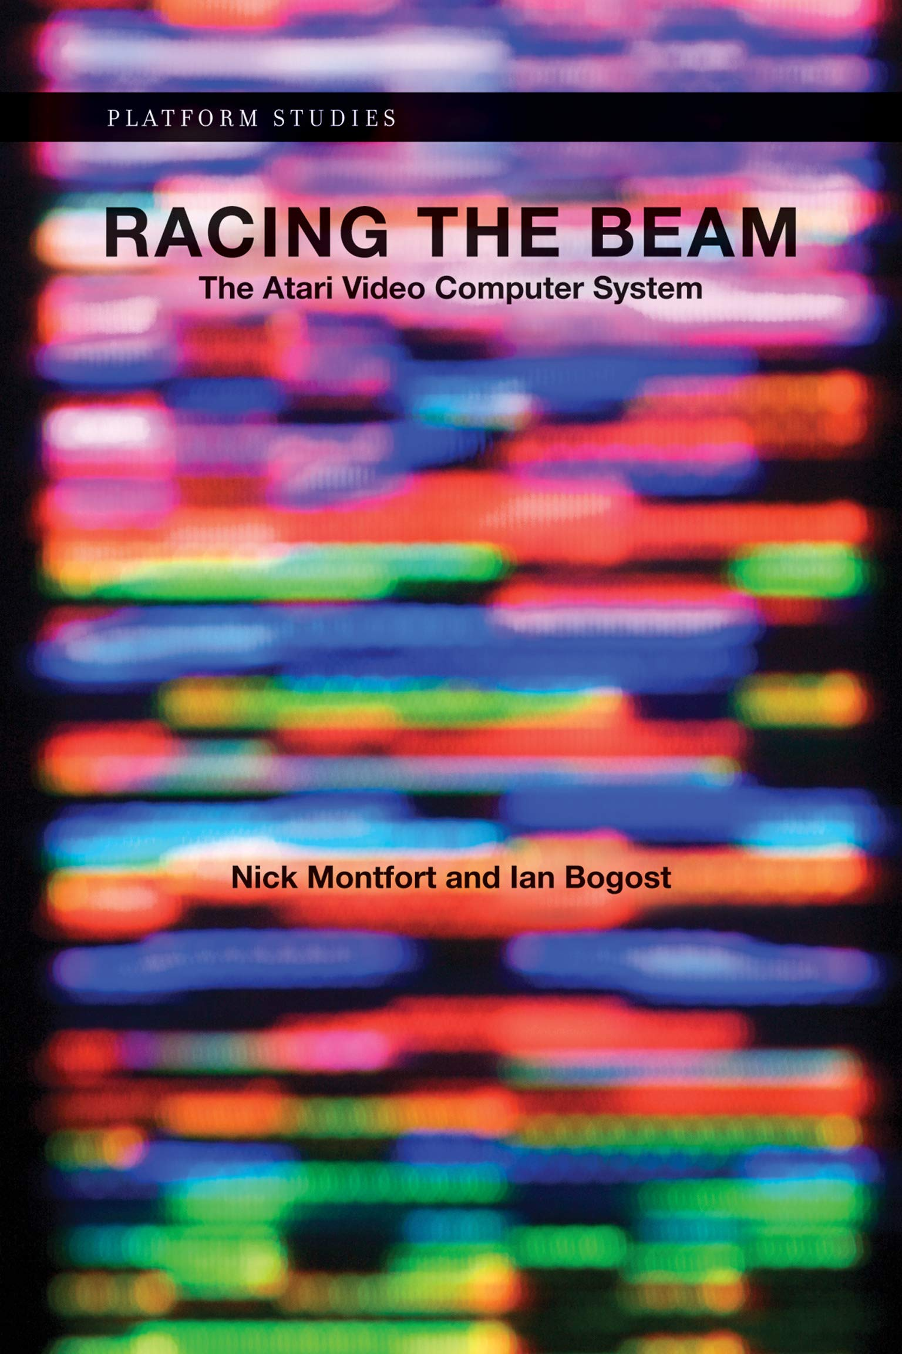
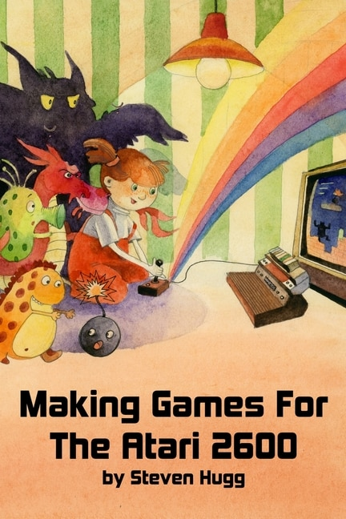

Slide 25
source code problems

Slide 26
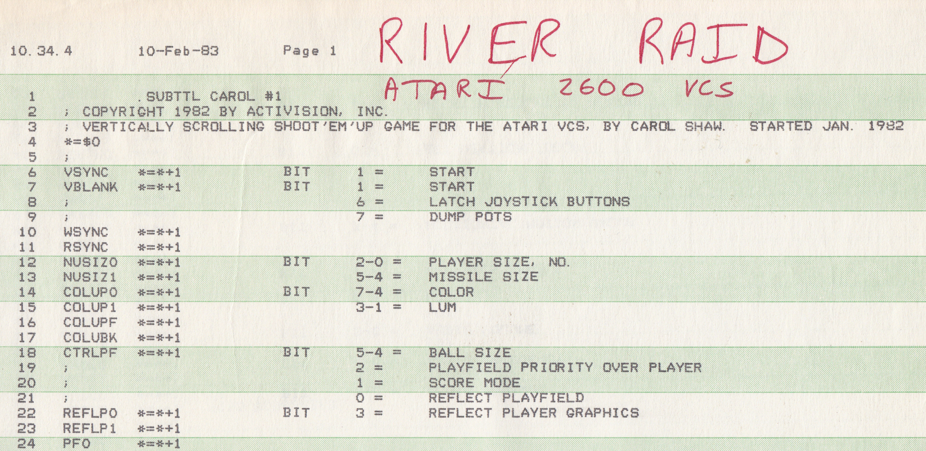

Slide 27
ET Challenge

Slide 28
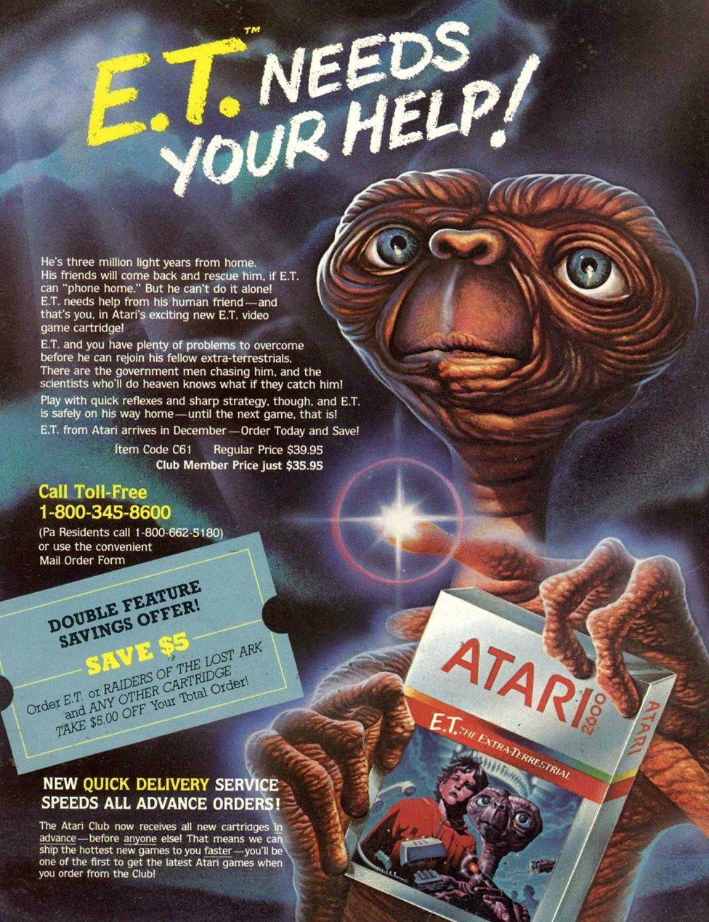
5 weeks alone? team? full game
Notes:
Activision had created design centers for their games, which were small, close-knit teams of four to five people.^{[19]} These teams encouraged peer reviews and shared prototypes of games. In Pitfall!, Crane's team changed the initial number of lives in the game from one to three during the final week of development.^{[20]} Crane said that "my buddies practically tied me to my chair until I put in extra lives and I'm glad they did".^{[20]}

Slide 29
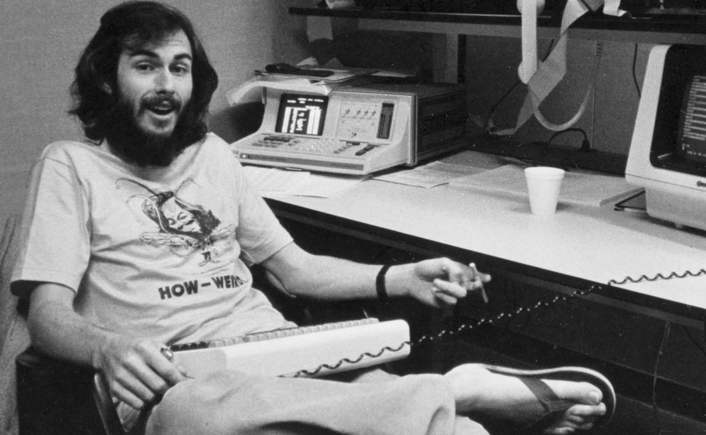

Slide 30
The Atari 2600 was a real mess.

Slide 31
It's a good thing that we don't try to program machines like that anymore because it was just absurd.

Slide 32
But it was kind of fun in a sick way if you like that kind of challenge.

Slide 33
dark souls of designing games

Slide 34
qcc?

